Slide 1
A CUSTOMISABLE AI DECK FOR PITCH REPORTS AND AUTOMATED THIRD UMPIRE DECISION REVIEW SYSTEM
Guided by: By:
Dr.P.Ramya Gowtham C.P
Kishore Kumar S
Renugadevi P
Silpica T.P

Slide 2
Abstract:
Nowadays giving fair verdict is a quite challenging task because of certain contentious aspects in modern cricket. So, in order to avoid making bad mistakes, we develop an automated AI-based solution. This project focuses on a technology that helps the umpire make critical determinations regarding whether the batsman is out or not and also minimizes the waiting time. A pitch report and comprehensive cricket laws are also included for the sake of the game. The pitch report will be examined for several key wicket characteristics, such as kind of soil, cracks, amount of grass cover, and wetness, etc.To determine the field cracks, canny edge detection is performed. This information helps cricket team to make a decision about whether to bat or field after winning the toss. Utilizing support vector machines (SVM) and histograms of gradients (HOG), objects are classified and recognized. In order to monitor and forecast the velocity of the ball, linear regression and quadratic regression are applied. Finally, Tkinter is used for GUI development and imutils and OpenCV are used as implementation tools.

Slide 3
INTRODUCTION
INTRODUCTION:
The International Cricket Council was established in 1914, and India joined the organisation in 1918. In 1918, Pakistan and South Africa joined the ICC alongside India.The ICC had plans to host a worldcup of 60-over ODI matches later in 1975. Due to time management, the ODI international innings were cut down to 50 overs after 1989.
There will be more chaos while giving lbw decisions without any technology.After technology development,the decision was made by video analysing system named HAWK EYE.Still there are some issues are in hawk eye method , so we came up with a solution to rectify those issues.
The pitch reports are also given through artificial intelligence without any help of experts.
Though there is an inconvinience for the team while onfield umpire make such decisions, we came up with cricket laws recommendation system too.

Slide 4
PROBLEM STATEMENT:
Currently available system is too time consuming due to the manual process, lot of laws are still unknown and which again adds a time-consuming problem and leads to unfair decisions. So, we are creating a customizable AI Deck for Automating Third Umpire Decision Review System, generating the pitch report for better team selection during the match day and it also includes the cricket laws for the fair decision using voice recognition search. The pitch report suggests the team to bat or bowl first after winning the toss. Better team suggestion and details of the stadium is also included in this system.

Slide 5
Objectives: DRS: To eliminate the flaws in the manual DRS method. PICTH REPORT: To choose whether to bat or bowl during toss. LAWS: To avoid controversies during the match.

Slide 6
EXISTING SYSTEM:
The existing system is a manual DRS method and the main umpire and the leg umpire need to pass it to the third umpire and there will be a huge delay in the decisions and sometimes it will lead to unfair decisions. The on-field umpire will feel humiliated when his decision is challenged again and again.Time has been proved that DRS technology is not completely reliable and has various glitches. This process has proved to be more error prone. Giving a limited and reviews also affects the game and the players. There may be ludicrous situation where tests are contested under different laws. This makes a mockery of fairness in test cricket. DRS has many weird rules associated with it like more than 50% of the impact on off stump should be these then only on-field decision can be overturned if the batsman’s leg is more than 2.5 meters from the stumps then the decision turns to not-out even if the ball is clearly headed towards the wicket. Sometimes it does not take into account the pitch condition, the revs on the ball or swing.

Slide 7
DRAWBACKS OF EXISTING SYSTEM:
Lack of clear rules and guidelines: Decision review systems are often not implemented with clear rules and guidelines that outline how the system should be used, which can lead to confusion and inconsistent decision-making.
Limited access to data: Many decision review systems lack access to the data necessary to make informed decisions, which can lead to decisions based on incomplete or inaccurate information.
Insufficient training: Without proper training and guidance, decision review systems can be used incorrectly or inefficiently, resulting in poor decision-making.
Difficulty in measuring/tracking results: It can be difficult to measure and track the results of a decision review system, making it difficult to determine whether the system is being used effectively.

Slide 8
PROPOSED SYSTEM:
DRS - sensors are placed in the stumps to figure out the trajectory of the ball path. The inputs came from the sensor and other fitted devices are processed using the program which is written in the software to make better decision with the aid of trained AI.
Pitch Report – The analysis of the cracks, grass, moisture, dust, climatic conditions, soil types to predict the wickets whether it is easy to bat or bowl.
Laws - All the 42 laws are added at a single place, it is searchable based on the categories and voice recognition-based search AI makes the search faster to provide fair decision by the umpires.
Better team suggestion – we are also using data science related tools to easily visualize and suggests a better team which can easily adapt for the conditions during the match.
These all features are then integrated into a single website with appropriate login’s both for the umpires as well as for the team management.

Slide 9
BENEFITS OF PROPOSED SYSTEM:
Reduce time to simulate LBW decision
Fair decision
Identify the best 11 players for a match according to the climate and pitch conditions.
Prediction of winning score.
Addition of laws will make audience easy to understand

Slide 10
SYSTEM ARCHITECTURE FOR DRS:

Slide 11
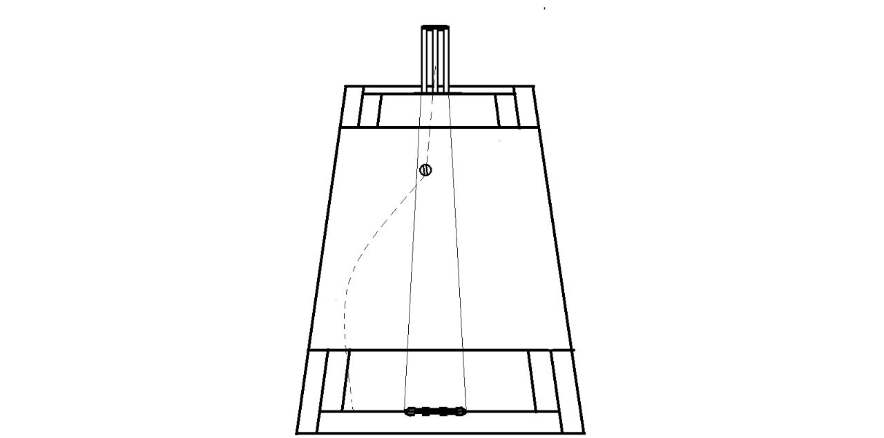
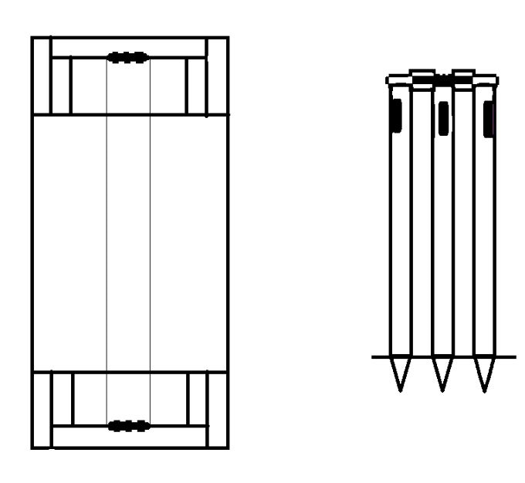
SYSTEM ARCHITECTURE FOR DRS:

Slide 12
SYSTEM ARCHITECTURE FOR PITCH REPORT:

Slide 13
MODULES:
Pitch Report
01
Decision Review System
02
Laws of cricket
03
04
01
02
03

Slide 14
DECISION REVIEW SYSTEM:
We have made a well advanced decision review system analyser to reduce time and make Leg Before the Wicket (LBW) decision more fair.
Now-a-days the umpires call in the DRS plays a vital role during some crucial decision making time.
Our implementation will make DRS automated to give a more fair decision,so there is no more need for third umpire analysis in DRS.
Linear regression and quadratic regression - used to track the path of the ball.
SVM and HOG - to classify and recognize the objects.

Slide 15
PITCH REPORT:
The analysis of the game will first go with what kind of condition that they are playing on that day.
The prior pitch report was given by the cricketing legends and experts who knows each and every pitch condition’
The analysis of pitch report was based on several kinds of natural behaviours like, soil type, wickets type, climatic condition on match day, moisture content available on the soil, dimension of the ground, cracks and depth & width of the cracks.
These analysis will give the team management to go with their best playing XI on matchday.

Slide 16
LAWS OF CRICKET:
Using laws the audience and the team management will come to an conclusion to on witch basis the on-field umpire makes the decision.
It helps to easily understand the laws using voice recognition.
The Umpires can cross check the laws incase of any unclear and unknown decisions.
Alan AI is used to search the laws with voice control.

Slide 17
Software/Hardware Requirements:
Software:
Jupyter Notebook - Model Building.
React.js - Web development
Tkinter - Stimulation of trajectory
Alan AI - Voice control
Hardware:
6 DOF sensors -to track the length of the ball.
LED based head band - to provide out or not out decisions.

Slide 18
THANK YOU

